Slide 1
Chapter 5a: CPU Scheduling
Basic Concepts
Scheduling Criteria
Scheduling Algorithms
Thread Scheduling
Multiple-Processor Scheduling
Real-Time CPU Scheduling
Operating Systems Examples
Algorithm Evaluation

Slide 2
Objectives
To introduce CPU scheduling, which is the basis for multiprogrammed operating systems
To describe various CPU-scheduling algorithms
To discuss evaluation criteria for selecting a CPU-scheduling algorithm for a particular system
To examine the scheduling algorithms of several operating systems

Slide 3

Basic Concepts
Maximum CPU utilization obtained with multiprogramming
Most processes exhibit the following behavior:
CPU burst followed by I/O burst
CPU–I/O Burst Cycle – Process execution consists of a cycle of CPU execution and I/O wait
CPU burst distribution is of main concern

Slide 4

Histogram of CPU-burst Times

Slide 5
CPU Scheduler
Whenever the CPU becomes idle, the operating system must select one of the processes in the ready queue to be executed.
The selection process is carried out by the CPU scheduler.
The ready queue may be ordered in various ways.
CPU scheduling decisions may take place when a process:
  1. Switches from running state to waiting state
  Switches from running state to ready state
  Switches from waiting state to ready state
  When a process terminates
For situations 1 and 4, there is no choice in terms of scheduling. A new process (if one exists in the ready queue) must be selected for execution.
There is a choice, however, for situations 2 and 3.

Slide 6
Nonpreemptive Scheduling
When scheduling takes place only under circumstances 1 and 4.
Under nonpreemptive scheduling, once the CPU has been allocated to a process, the process keeps the CPU until it releases the CPU either by terminating or by switching to the waiting state.

Slide 7
Preemptive scheduling
When scheduling takes place only under circumstances 2 and 3
Preemptive scheduling can result in race conditions when data are shared among several processes.
  Consider the case of two processes that share data. While one process is updating the data, it is preempted so that the second process can run. The second process then tries to read the data, which are in an inconsistent state.
  Consider preemption while in kernel mode
  Consider interrupts occurring during crucial OS activities
Virtually all modern operating systems including Windows, Mac OS X, Linux, and UNIX use preemptive scheduling algorithms.

Slide 8
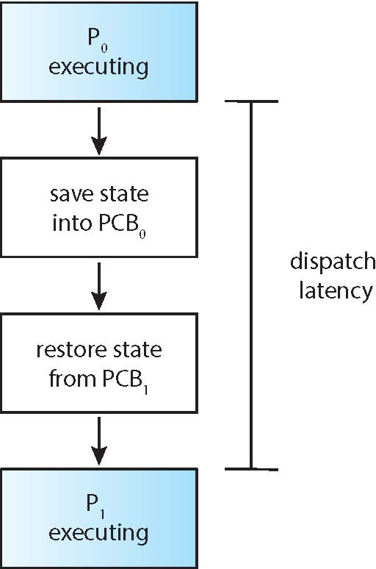
Dispatcher
Dispatcher module gives control of the CPU to the process selected by the CPU scheduler; this involves:
  switching context
  switching to user mode
  jumping to the proper location in the user program to restart that program
Dispatch latency – time it takes for the dispatcher to stop one process and start another running

Slide 9
Scheduling Criteria
CPU utilization – keep the CPU as busy as possible
Throughput – number of processes that complete their execution per time unit (e.g., 5 per second)
Turnaround time – amount of time to execute a particular process (Submission of Process to Completion)i.e.(Waiting to get into memory+ Waiting in ready queue+ Executing on the CPU+ Doing IO)
Waiting time – total amount of time a process has been waiting in the ready queue (Sum of periods spent waiting in the ready queue)
Response time – amount of time it takes from when a request was submitted until the first response is produced, not output (for time-sharing environment)

Slide 10
Optimization Criteria for Scheduling
Max CPU utilization
Max throughput
Min turnaround time
Min waiting time
Min response time

Slide 11
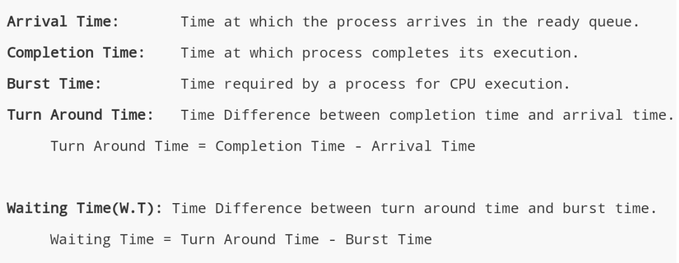

Slide 13
Scheduling Algorithm
First –come, First-serve (FCFS)
Shortest-Job-First Scheduling (SJF)
Round-Robin Scheduling (RR)
Priority Scheduling
Multilevel Queue Scheduling

Slide 14

First- Come, First-Served (FCFS) Scheduling
Consider the following three processes and their burst time
Process Burst Time
P₁ 24
P₂ 3
P₃ 3
Suppose that the processes arrive in the order: P₁ , P₂ , P₃
We use Gantt Chart to illustrate a particular schedule
Waiting time for P₁ = 0; P₂ = 24; P₃ = 27
Average waiting time: (0 + 24 + 27)/3 = 17

Slide 15

FCFS Scheduling (Cont.)
Suppose that the processes arrive in the order:
P₂ , P₃ , P₁
The Gantt chart for the schedule is:
Waiting time for P₁ = 6; P₂ = 0; P₃ = 3
Average waiting time: (6 + 0 + 3)/3 = 3
Much better than previous case
Convoy effect - short process behind long process
  Consider one CPU-bound and many I/O-bound processes

Slide 16
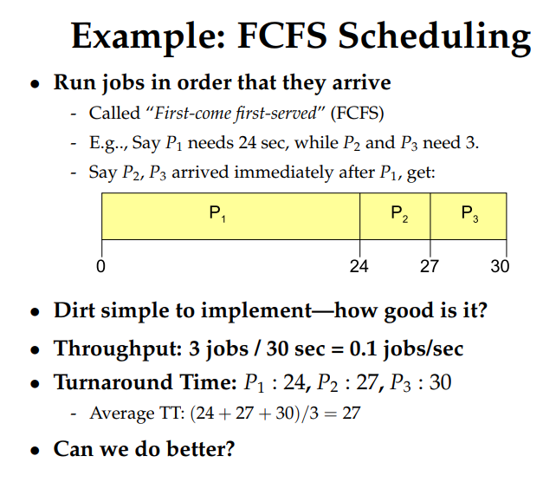

Slide 17
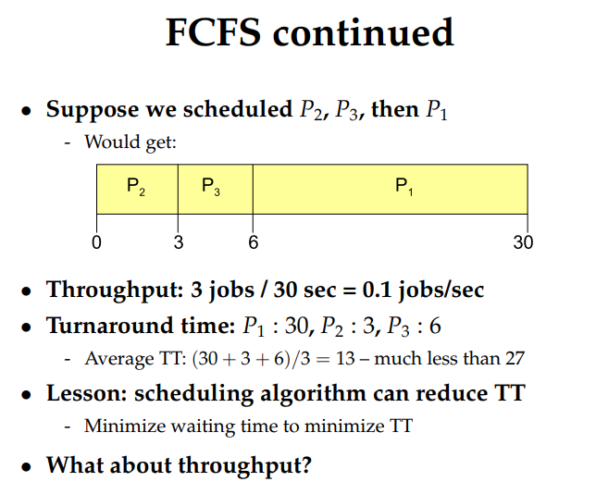

Slide 18
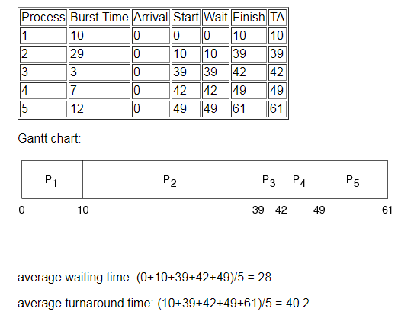

Slide 19
Shortest-Job-First (SJF)
Associate with each process the length of its next CPU burst
  Use these lengths to schedule the process with the shortest time
SJF is optimal – gives minimum average waiting time for a given set of processes
  How do we know what is the length of the next CPU request
  Could ask the user
    what if the user lies?

Slide 20

Example of SJF
Consider the following four processes and their burst time
ProcessArriva l Time Burst Time
P₁ 0.0 6
P₂ 2.0 8
P₃ 4.0 7
P₄ 5.0 3
SJF scheduling chart
Average waiting time = (3 + 16 + 9 + 0) / 4 = 7
Where FCFS AWT=10.25

Slide 21
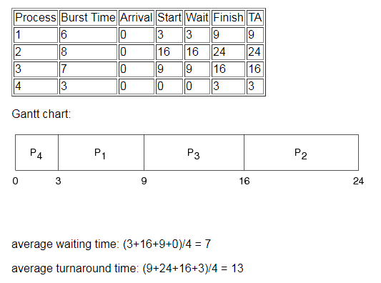
Example

Slide 22
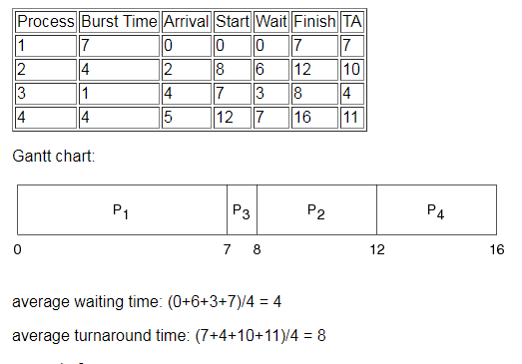

Slide 23
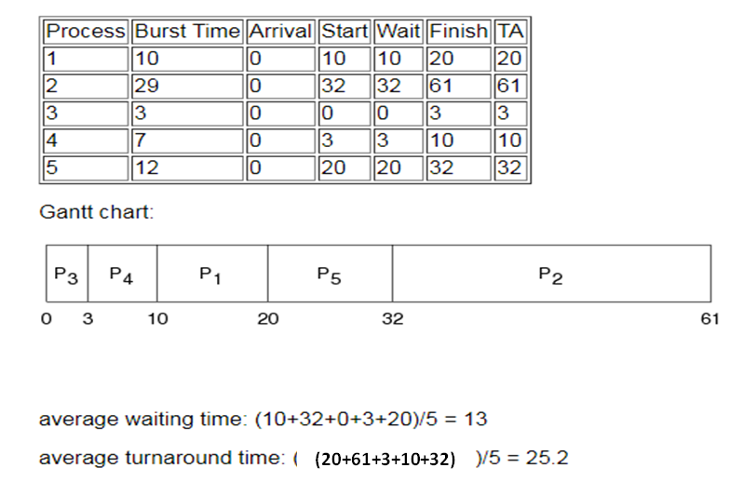

Slide 24
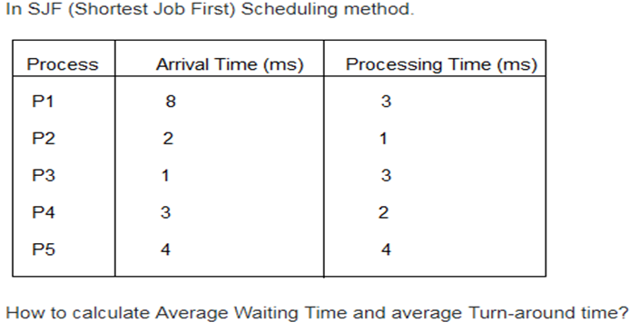

Slide 25
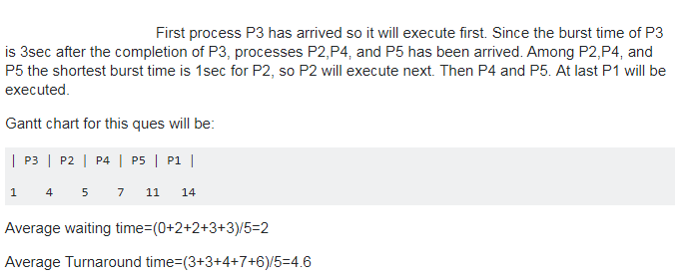

Slide 26


Determining Length of Next CPU Burst
Can only estimate (predict) the length – in most cases should be similar to the previous CPU burst
  Pick the process with shortest predicted next CPU burst
Can be done by using the length of previous CPU bursts, using exponential averaging
Commonly, α set to ½

Slide 27
Examples of Exponential Averaging
α =0
  τ_{n+1} = τ_{n}
  Recent history does not count
α =1
  τ_{n+1} = t_{n}
  Only the actual last CPU burst counts
If we expand the formula, we get:
    τ_{n+1} = α t_{n}+(1 - α)α t_{n} ₋₁ + …
    +(1 - α )^{j} α t_{n} _{-j} + …
    +(1 - α )^{n +1} τ₀
Since both α and (1 - α) are less than or equal to 1, each successive term has less weight than its predecessor

Slide 28

Prediction of the Length of the Next CPU Burst

Slide 29

Shortest-remaining-time-first
Preemptive version of SJF is called shortest-remaining-time-first
Example illustrating the concepts of varying arrival times and preemption.
ProcessA arri Arrival TimeT Burst Time
P₁ 0 8
P₂ 1 4
P₃ 2 9
P₄ 3 5
Preemptive SJF Gantt Chart
Average waiting time = [(10-1)+(1-1)+(17-2)+(5-3)]/4 = 26/4 = 6.5 msec.
Where non preemptive SJF AWT is 7.75

Slide 30
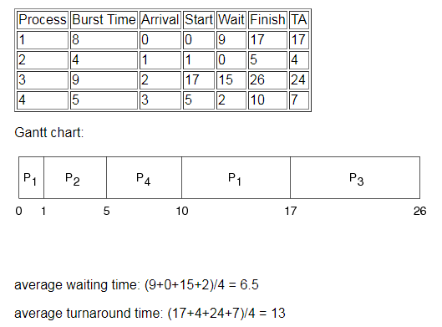

Slide 31
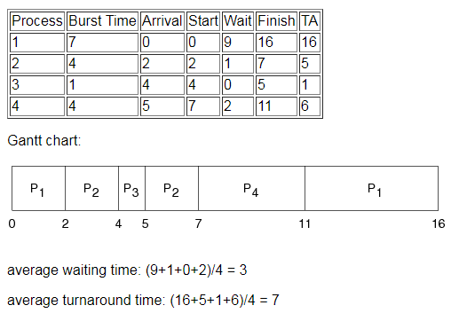

Slide 32
Round Robin (RR)
Each process gets a small unit of CPU time (time quantum q). After this time has elapsed, the process is preempted and added to the end of the ready queue.
If there are N processes in the ready queue and the time quantum is q, then each process gets 1/N of the CPU time in chunks of at most q time units at once. No process waits more than (N-1)q time units.
Timer interrupts every quantum to schedule next process
Performance
  q large ⇒ FIFO
  q small ⇒ q must be large with respect to context switch, otherwise overhead is too high

Slide 33
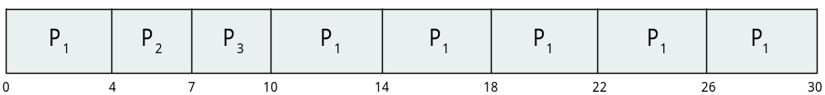
Example of RR with Time Quantum = 4
Consider the following three processes and their burst time
Process Burst Time
P₁ 24
P₂ 3
P₃ 3
The Gantt chart is:
The average waiting time under the RR policy is often longer
AWT=(10-4)+(4)+(7)=17/3=5.66 ms
Typically, higher average turnaround than SJF, but better response
q should be large compared to context switch time
q is usually 10ms to 100ms, context switch < 10 usec

Slide 34
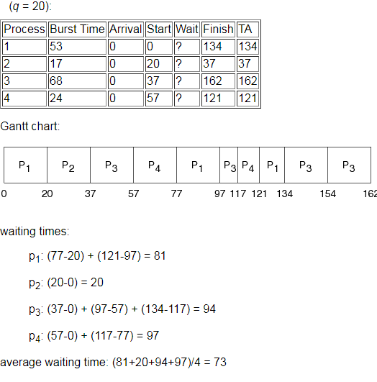

Slide 35
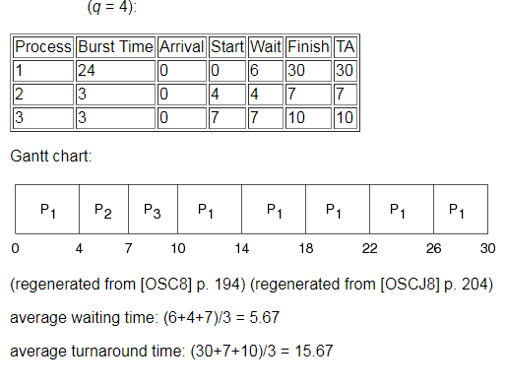

Slide 36
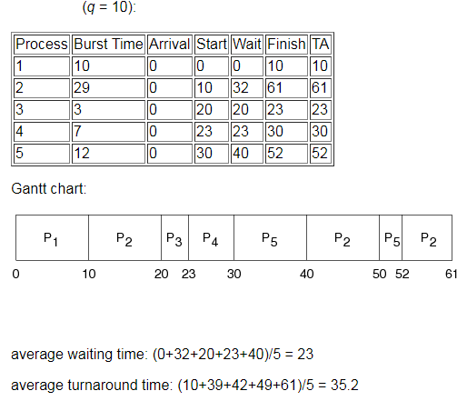

Slide 37

Time Quantum and Context Switch Time
The performance of the RR algorithm depends on the size of the time quantum. If the time quantum is extremely small (say, 1 millisecond), RR can result in a large number of context switches.

Slide 38

Turnaround Time Varies With The Time Quantum
The average turnaround time of a set of processes does not necessarily improve as the time-quantum size increases. In general, the average turnaround time can be improved if most processes finish their next CPU burst in a single time quantum.

Slide 39
Priority Scheduling
A priority number (integer) is associated with each process
The CPU is allocated to the process with the highest priority (smallest integer ≡ highest priority)
  Preemptive
  Nonpreemptive
SJF is priority scheduling where priority is the inverse of predicted next CPU burst time
Problem ≡ (indefinite blocking) Starvation – low priority processes may never execute
Solution ≡ Aging – as time progresses increase the priority of the process

Slide 40

Example of Priority Scheduling
Consider the following five processes and their burst time
ProcessA arri Burst TimeT Priority
P₁ 10 3
P₂ 1 1
P₃ 2 4
P₄ 1 5
P₅ 5 2
Priority scheduling Gantt Chart
Average waiting time = 8.2 msec

Slide 41
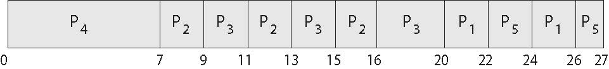
Combining Priority Scheduling and RR
System executes the highest priority process; processes with the same priority will be run using round-robin.
Consider the following five processes and their burst time
ProcessA arri Burst TimeT Priority
P₁ 4 3
P₂ 5 2
P₃ 8 2
P₄ 7 1
P₅ 3 3
Priority scheduling Gantt Chart
Average waiting time = 8.2 msec

Slide 42
